Slide 1


Slide 2


Slide 3
Until now: low/mid level vision
Low level
Pixel manipulations
Image corrections
Feature extraction
Mid level
Images <-> images
Panorama
Image <-> world
Stereo
Images <-> time
Optical flow

Slide 4
Why did we extract these features anyway?
High level vision!
Image <-> semantics, meaning
Make predictions about images, what’s in them
How do we make predictions?
Hard coded rules?
Learn things from data!
Time to learn all of machine learning in one class
(haha not really)

Slide 5
What is machine learning?
Algorithms to approximate functions
Usually use lots of statistics
Usually minimize some form of loss function
Supervised learning
Given inputs to a function, try to predict the output
Have lots of labelled examples
Semi-supervised learning
Same but number of labelled examples < number of examples
Unsupervised learning
Want to model unlabelled data
Find similarities and differences between subgroups of data
Learn functions to generate new data

Slide 6
Unsupervised learning
No labels, just looking for patterns in data
E.g. clustering, in data with multiple clusters, what are they, how big, etc.

Slide 7
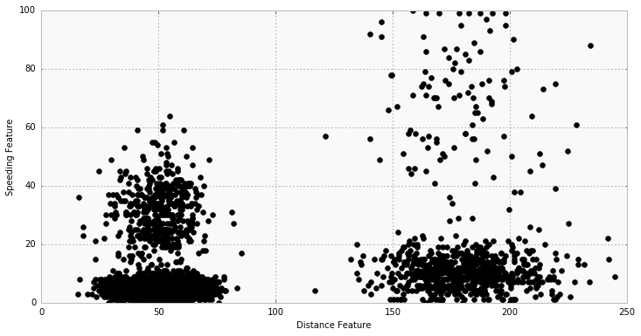
Clustering: finding groups in data

Slide 8
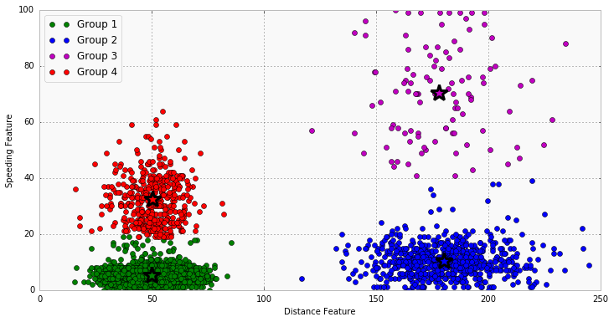
Clustering: finding groups in data

Slide 9

K-means clustering
https://healthcare.ai/step-step-k-means-clustering/
Assume points are close to other points in group, far from points out of group
Algorithm:
Randomly initialize cluster centers

Slide 10
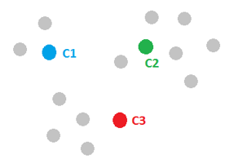
K-means clustering
https://healthcare.ai/step-step-k-means-clustering/
Assume points are close to other points in group, far from points out of group
Algorithm:
Randomly initialize cluster centers

Slide 11
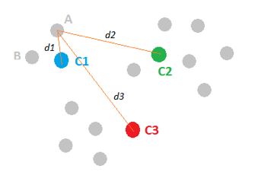
K-means clustering
https://healthcare.ai/step-step-k-means-clustering/
Assume points are close to other points in group, far from points out of group
Algorithm:
Randomly initialize cluster centers Calculate distance points <-> centers

Slide 12
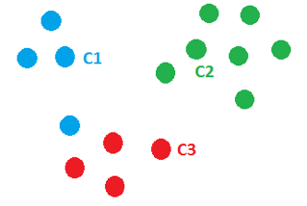
K-means clustering
https://healthcare.ai/step-step-k-means-clustering/
Assume points are close to other points in group, far from points out of group
Algorithm:
Randomly initialize cluster centers Calculate distance points <-> centers Assign each point to closest cluster center

Slide 13
K-means clustering
https://healthcare.ai/step-step-k-means-clustering/
Assume points are close to other points in group, far from points out of group
Algorithm:
Randomly initialize cluster centers Calculate distance points <-> centers Assign each point to closest cluster center Update cluster centers: avg of points

Slide 14
K-means clustering
https://healthcare.ai/step-step-k-means-clustering/
Assume points are close to other points in group, far from points out of group
Algorithm:
Randomly initialize cluster centers Calculate distance points <-> centers Assign each point to closest cluster center Update cluster centers: avg of points Repeat!

Slide 15
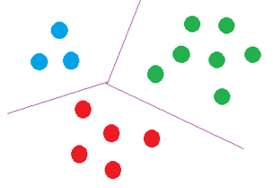
K-means clustering
https://healthcare.ai/step-step-k-means-clustering/
Assume points are close to other points in group, far from points out of group
Algorithm:
Randomly initialize cluster centers Loop until converged: Calculate distance points <-> centers Assign each point to closest center Update cluster centers: avg of points

Slide 16


Clustering on images
Group together pixels by color, automatic segmentation: k-means, k = 2

Slide 17
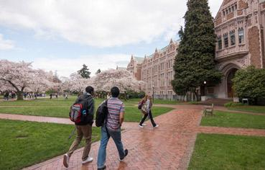
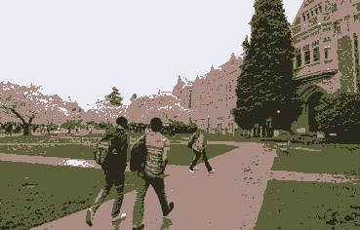
Clustering on images
Group together pixels by color, automatic segmentation: k-means, k = 4

Slide 18
Supervised Learning: Want to estimate f
f(x)
(dependent variable)
(label)
x (independent variable)

Slide 19
Here’s one possible f*
f(x)
(dependent variable)
(label)
x (independent variable)

Slide 20
Data often has noise
Why?
f(x)
(dependent variable)
(label)
x (independent variable)

Slide 21
Data often has noise
Why?
Randomness
Static in phone lines, random distribution of photons hitting sensor, sensors aren’t precise
Mislabelled data
Common when humans label lots of data
Variables outside of model
Variations might look like noise but are explained by a hidden, unknown variable

Slide 22
Data often has noise
Do we want a more complex f*?
f(x)
(dependent variable)
(label)
x (independent variable)

Slide 23
Sometimes the data is more complex
Which model is right?
f(x)
(dependent variable)
(label)
x (independent variable)

Slide 24
Bias / Variance tradeoff
Bias
Error from assumptions model makes about data
Linear model assumes data is linear, bad for data that isn’t
f(x)
x

Slide 25
Bias / Variance tradeoff
Bias
Error from assumptions model makes about data
Linear model assumes data is linear, bad for data that isn’t
Quadratic is better
f(x)
x

Slide 26
Bias / Variance tradeoff
Variance
Algorithm’s sensitivity to noise
More complex algorithms are more sensitive!
f(x)
x

Slide 27
Bias / Variance tradeoff
Variance
Algorithm’s sensitivity to noise
More complex algorithms are more sensitive!
f(x)
f(x)
x
x

Slide 28
Bias / Variance tradeoff
Variance
Algorithm’s sensitivity to noise
More complex algorithms are more sensitive!
High variance hurts generalization, overfitting
f(x)
f(x)
x
x

Slide 29
Bias / Variance tradeoff
Noise
Random variations in data
Bias
Error from assumptions model makes about data
Less complex algorithms -> more assumptions about data
Variance
Algorithm’s sensitivity to noise
More complex algorithms are more sensitive!
High variance hurts generalization

Slide 30
Linear regression
f*(x) = ax + b
Learn a and b from data (how?)
f(x)
x

Slide 31
Linear regression
f*(x) = ax + b
Learn a and b from data (how?)
Minimize squared error!
Loss function L(f*) = Σ_{i} ||f(x_{i}) - f*(x_{i})||²
f(x)
x

Slide 32
Linear regression
f*(x) = ax + b
Learn a and b from data (how?)
Minimize squared error!
Loss function L(f*) = Σ_{i} ||f(x_{i}) - f*(x_{i})||²
Want argmin_{a,b}[L(f*)]
Extrema when derivative = 0
f(x)
x

Slide 33
Linear regression
f*(x) = ax + b
Learn a and b from data (how?)
Minimize squared error!
Loss function L(f*) = Σ_{i} ||f(x_{i}) - f*(x_{i})||²
Want argmin_{a,b}[L(f*)]
Extrema when derivative = 0
Solve linear system of equations
Ma = b
Already did this!
f(x)
x

Slide 34
Linear regression
f*(x) = ax + b
Learn a and b from data (how?)
High bias: linear assumption
Low variance
Benefits:
Closed form solution
Fast to compute for new data
f(x)
x

Slide 35
Linear regression
f*(x) = ax + b
Learn a and b from data (how?)
High bias: linear assumption
Low variance
Benefits:
Closed form solution
Fast to compute for new data
Weaknesses:
Not very powerful, assumes linear
Underfit more interesting data
f(x)
x

Slide 36
(Aside) Convex vs Non-convex
Convex function: connect any two points on graph with a line, that line lies above function everywhere
Why is it important? Any local extrema is global extrema!
If our loss function is convex, can set derivative = 0, solve for parameters (sometimes still no closed-form)
f(x)

Slide 37
(Aside) Convex vs Non-convex
Non-convex function: no rules!
Local optima are not global optima
Usually no easy way to find global or local optima, harder to optimize
f(x)

Slide 38
Nearest neighbor
f*(x) = f(x’) for nearest x’ in training set
f(x)
x

Slide 39
Nearest neighbor
f*(x) = f(x’) for nearest x’ in training set
Low bias: no assumptions about data
High variance: very sensitive to training set
f(x)
x

Slide 40
Nearest neighbor
f*(x) = f(x’) for nearest x’ in training set
Low bias: no assumptions about data
High variance: very sensitive to training set
Benefits:
Super easy to implement
Easy to understand
Arbitrarily powerful, esp with lots of data
f(x)
x

Slide 41
Nearest neighbor
f*(x) = f(x’) for nearest x’ in training set
Low bias: no assumptions about data
High variance: very sensitive to training set
Benefits:
Super easy to implement
Easy to understand
Arbitrarily powerful, esp with lots of data
Weaknesses:
Hard to scale
Prone to overfitting to noise
f(x)
x

Slide 42
These are examples of regression
Given training data
input variables X, output variables Y
And new data point x’
Predict corresponding output variables y’
f(x)
f(x)
x
x

Slide 43
A different task: Classification
Training data: points associated with a class
Also other data about that point
Example: Does patient have the flu?
Binary classification (yes or no)
Different types of variables (continuous, discrete)
sore throat | runny nose | nausea | temp | chills | pain | age | days | diagnosis
no | yes | yes | 101.3 | yes | 7 | 15 | 5 | flu
yes | yes | no | 98.8 | no | 3 | 74 | 3 | not flu
yes | yes | no | 100.1 | yes | 4 | 46 | 4 | flu
yes | yes | yes | 99.8 | yes | 6 | 27 | 1 | flu
yes | no | no | 98.4 | yes | 5 | 35 | 2 | not flu
yes | yes | yes | 99.0 | no | 3 | 42 | 4 | not flu

Slide 44
One approach: partitions
Find best split or splits to data along one variable
One possibility, Pr(flu) = (temp > 99.5)
Pretty accurate on our training data
sore throat | runny nose | nausea | temp | chills | pain | age | days | diagnosis
no | yes | yes | 101.3 | yes | 7 | 15 | 5 | flu
yes | yes | no | 98.8 | no | 3 | 74 | 3 | not flu
yes | yes | no | 100.1 | yes | 4 | 46 | 4 | flu
yes | yes | yes | 99.8 | yes | 6 | 27 | 1 | flu
yes | no | no | 98.4 | yes | 5 | 35 | 2 | not flu
yes | yes | yes | 99.9 | no | 3 | 42 | 4 | not flu

Slide 45
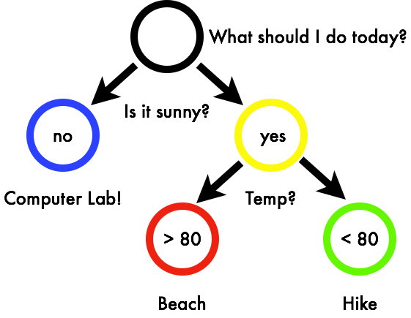
Trees: layers of partitions
Very simple models
Benefits: Interpretable Easy to use Good for applications E.g. medicine

Slide 46
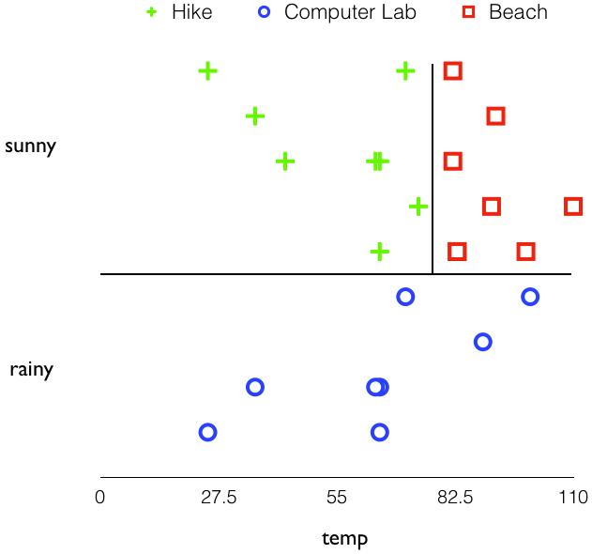
Trees are partitions of data

Slide 47

Predict new data based on what region it falls into

Slide 48
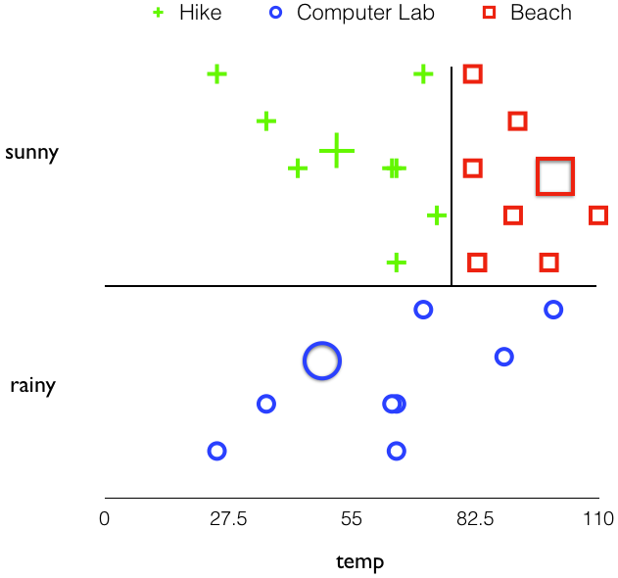
Predict new data based on what region it falls into

Slide 49
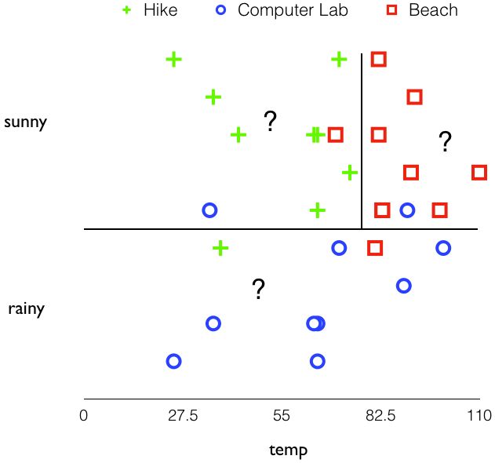
Data might be noisy, use soft assignments

Slide 50
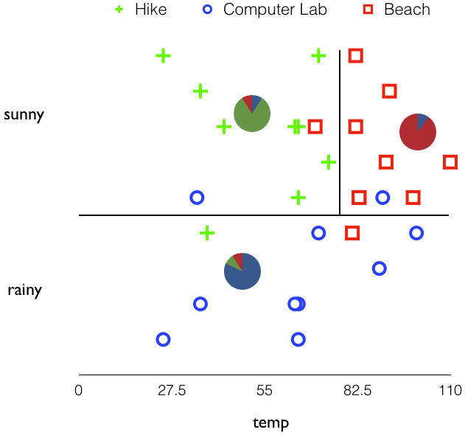
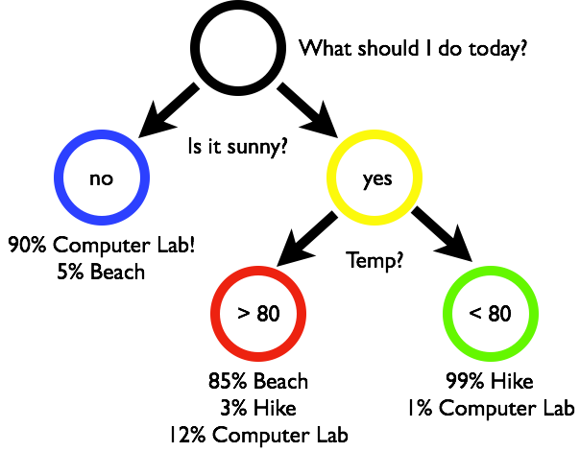
Data might be noisy, use soft assignments

Slide 51
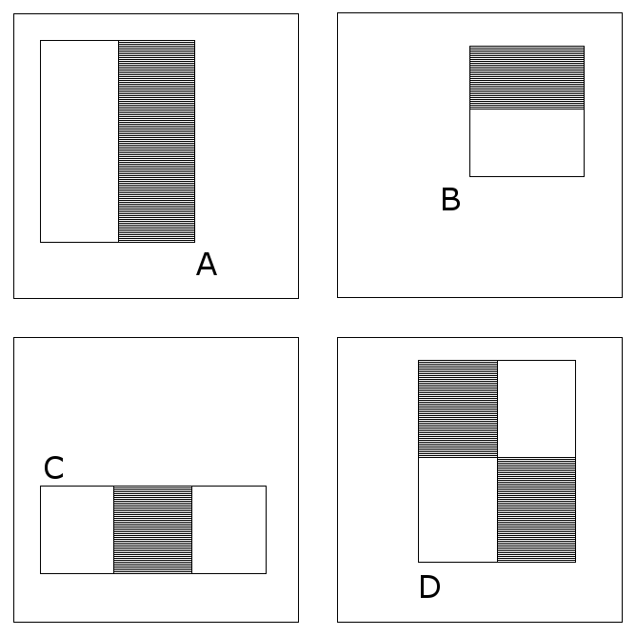
Case study: Viola-Jones Face detection
https://www.cs.cmu.edu/~efros/courses/LBMV07/Papers/viola-cvpr-01.pdf
Want it to be very fast and accurate Run on a camera or cell phone, low cost
Use simple features and simple classifiers
Haar features:
Response = Σ pix in black region - Σ pix in white region

Slide 52
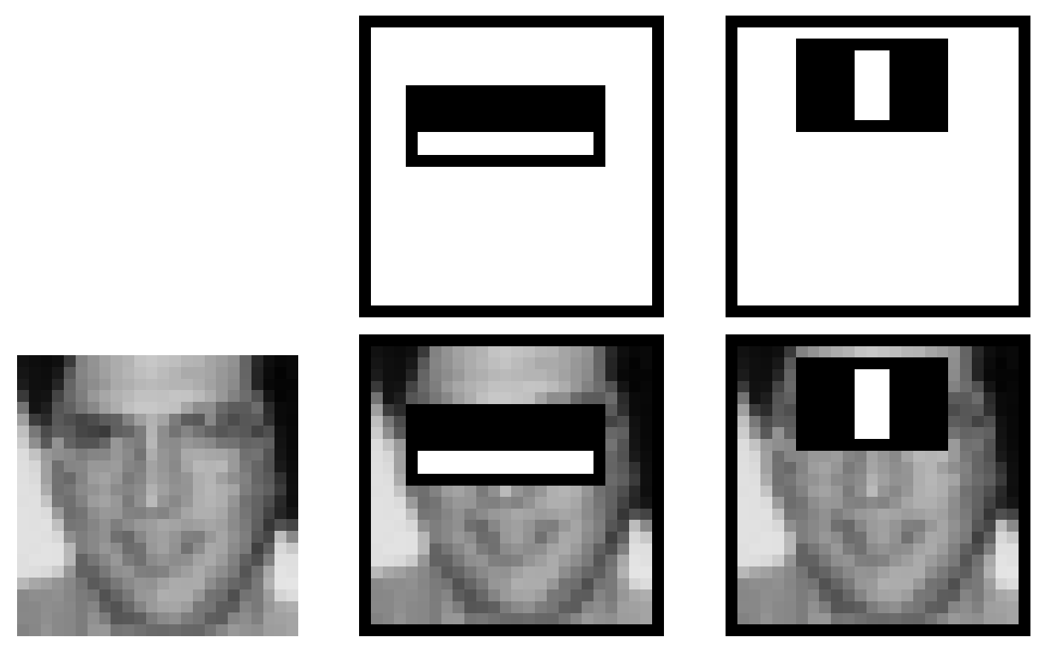
Case study: Viola-Jones Face detection
https://www.cs.cmu.edu/~efros/courses/LBMV07/Papers/viola-cvpr-01.pdf
Why do Haar features work? Eyes are generally darker than cheeks Bridge of nose lighter than eyes Etc.
Also, fast to compute! Integral images - fast sums over regions.

Slide 53
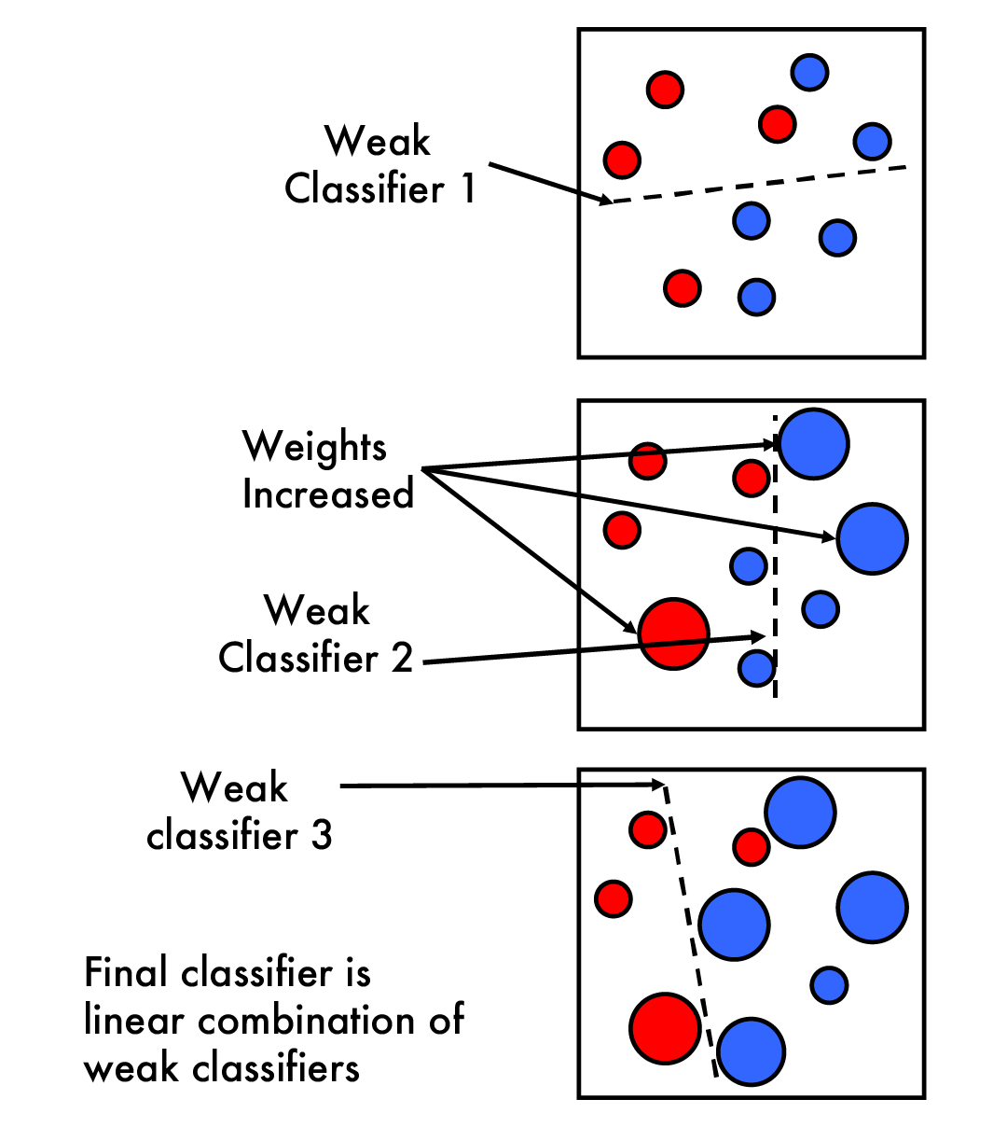
Case study: Viola-Jones Face detection
https://www.cs.ubc.ca/~lowe/425/slides/13-ViolaJones.pdf
Classifier: boosted partitions
Boosting Way to make weak classifiers better Train a weak classifier

Slide 54
Case study: Viola-Jones Face detection
https://www.cs.ubc.ca/~lowe/425/slides/13-ViolaJones.pdf
Classifier: boosted partitions
Boosting Way to make weak classifiers better Train a weak classifier Reweight data we got wrong, train again

Slide 55
Case study: Viola-Jones Face detection
https://www.cs.ubc.ca/~lowe/425/slides/13-ViolaJones.pdf
Classifier: boosted partitions
Boosting Way to make weak classifiers better Train a weak classifier Reweight data we got wrong, train again ...and again Until you feel like stopping
Final classifier is combination of these

Slide 56
Case study: Viola-Jones Face detection
Finally, use a cascade of classifiers
1st classifier Very fast, throws out easy negatives
2nd classifier Fast, throws out harder negatives
3rd classifier Slower, throws out hard negatives
Only run slow, good classifiers on hard examples Fast classifier that is still very accurate

Slide 57
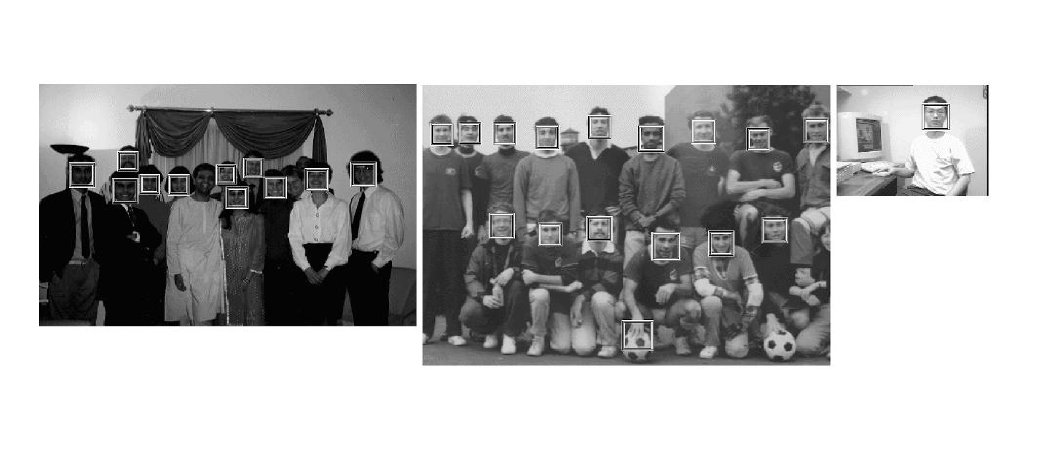
Case study: Viola-Jones Face detection
Haar features Cascade Of boosted classifiers

